Slide 1
數位信號處理實驗 (DSP)
DSP專題二 (1/2)
電機系 方士豪 教授

Slide 2
課程規範 (1/2)
出勤規則
14:10未到者以遲到計：總成績-1分。
14:30未到者以曠課計：總成績-2分，且當次作業成績以0分計算。
點名時人一定要在現場，不在位上以遲到/曠課論，如有要事暫時離開請先告知助教。
超過3次(含)曠課者，期末總成績不及格。
請假規則
公/事假須在3天前到Portal辦理網路請假，未請假者以曠課計。
病假請在下次上課前將病假證明送至70639給助教，未提供者以曠課計。
作業繳交規定
作業請於課程結束當日上傳至Portal，逾時繳交以0分計算，請假者請參照補交規定。
作業、專題抄襲者以0分計算。

Slide 3
課程規範 (2/2)
請假者補交作業規定
專題1：當次作業成績打9折
A班補交期限為 12/19 17:00前
B班補交期限為 12/19 17:00前
專題2：當次作業成績打9折
A班補交期限為 1/13 17:00前
B班補交期限為 1/13 17:00前
超過補交期限不再受理補交。
其他注意事項
教室內禁止飲食，飲料及食品請勿攜入。
離開時請將桌面清理乾淨，並將垃圾攜出。
請勿隨意拔插網路線或電源線，若電腦出現問題請向助教反映。

Slide 4
時程規劃與配分
日期 | 上課內容 | 報告
12/21 | 專題(二)
12/28 | 專題(二)
1/4 | 專題(二) | 專題二繳交(1/11 17:00前)

Slide 5
Signal Processing
1
Facebook of IEEE signal processing society
https://www.facebook.com/ieeeSPS
2
What is signal processing
https://youtu.be/EErkgr1MWw0
3
Review
Digital audio/Speech signal processing (a typical case)
Matlab (6 weeks)

Slide 6
Some cool products/projects (1/4)
1
藍芽無線頭巾式耳機
2
微型無線樂器麥克風
3
"Man vs Robot" in playing Angry Birds
4
SILENT PARTNER 消除打呼聲的眼罩
5
Spear X 聲特耳機
6
MEATER 無線智能溫度計
7
Adobe Project VoCo - 音檔不用重新錄製就能增加新句子
8
Speech Translation (翻譯米糕)

Slide 7
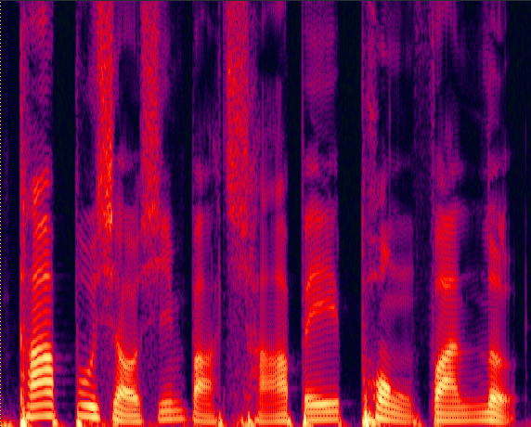
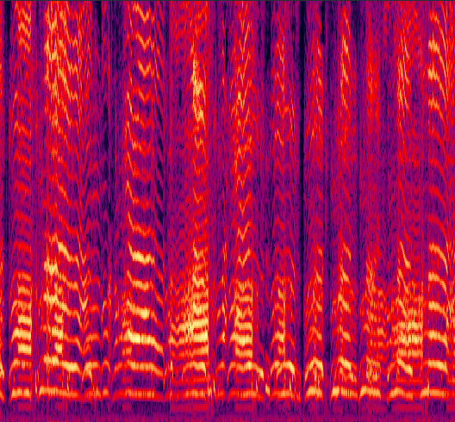
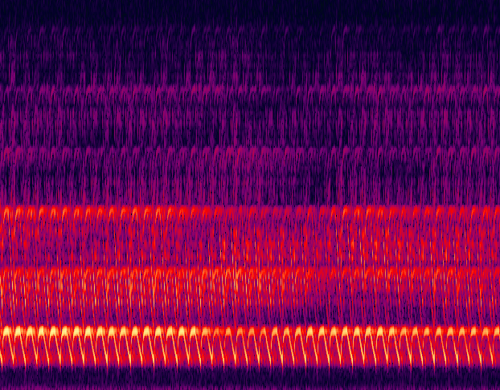

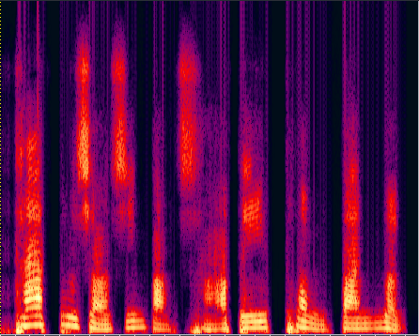
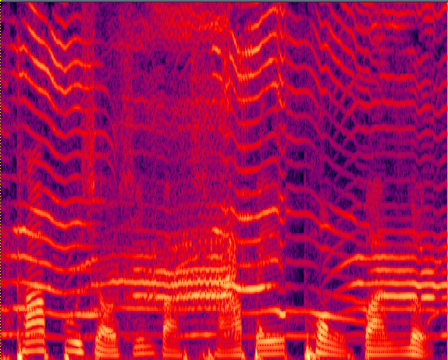
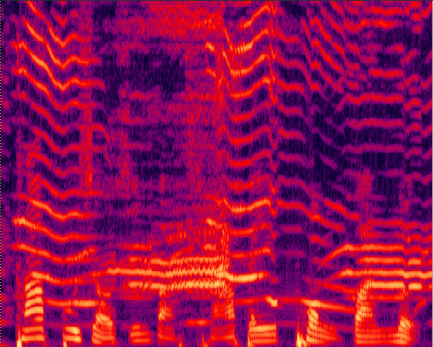
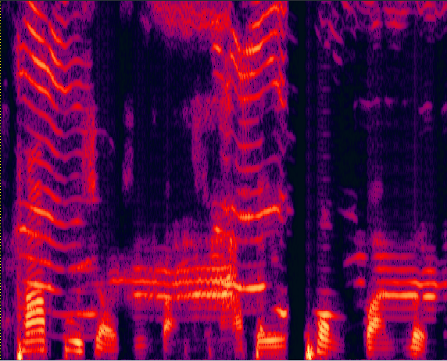
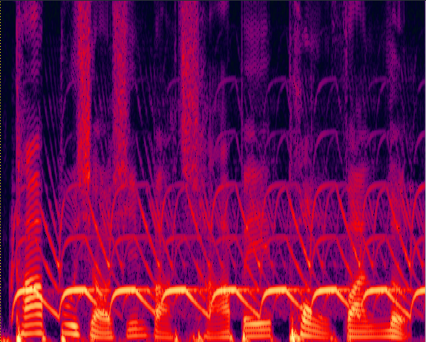
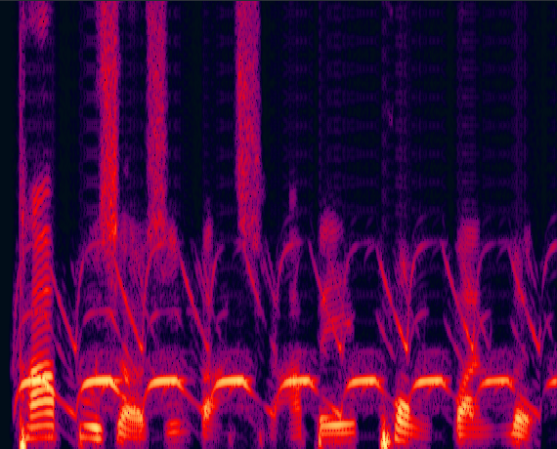
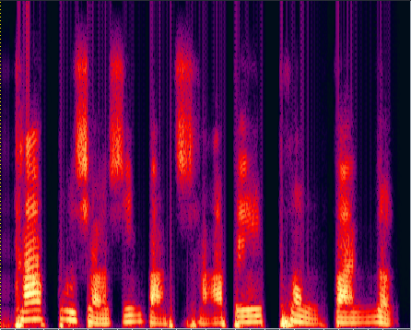
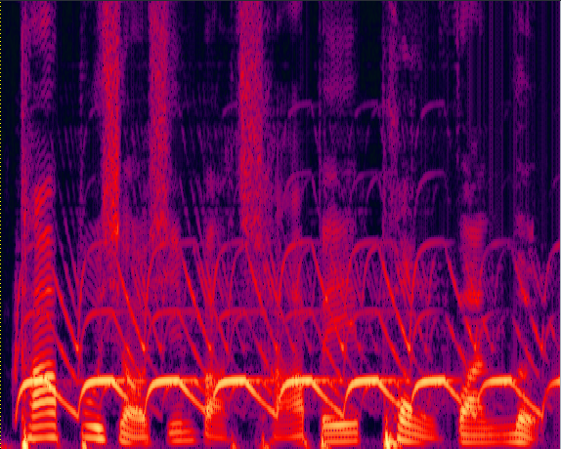
Some cool products/projects (2/4)
 | Clean speech | Noise: 2baby Crying | Noise: Siren
2baby Crying | Original Noisy | MMSE (Trandtional-1) | KLT (Trandtional-2) | DAE
Siren | Original Noisy | MMSE (Trandtional-1) | KLT (Trandtional-2) | DAE

Slide 8
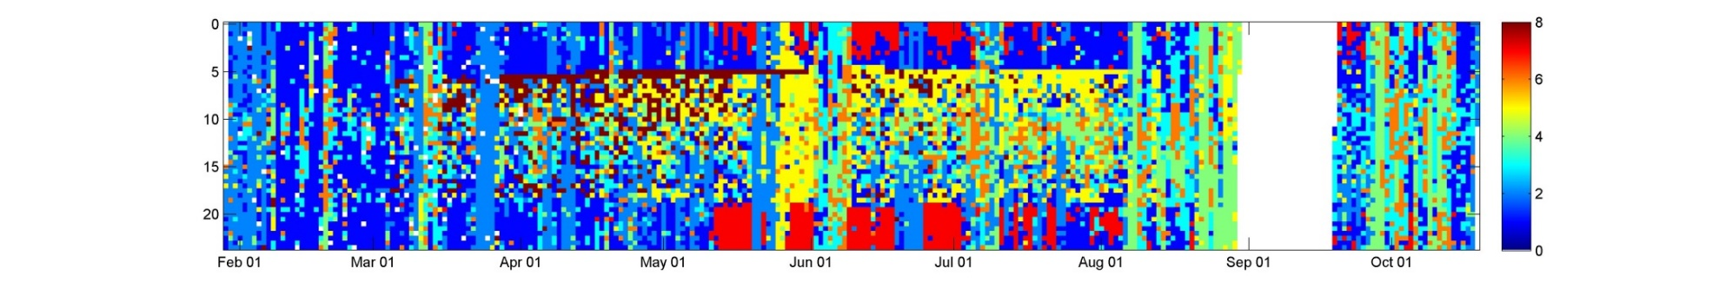
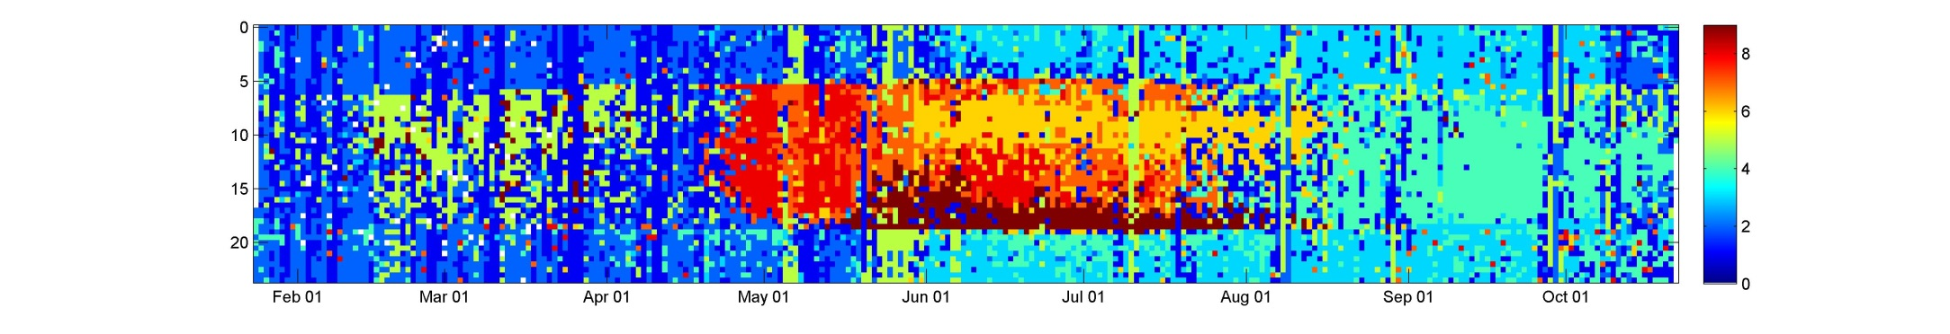
Some cool products/projects (3/4)
宜蘭太平山
苗栗三義

Slide 9
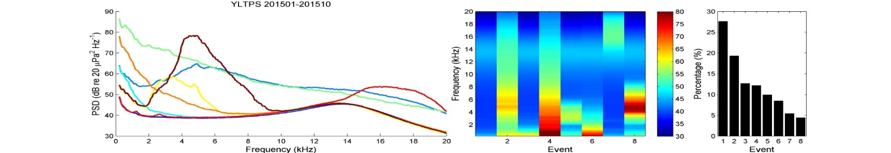
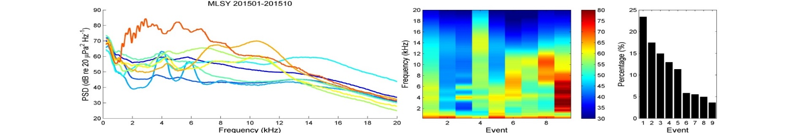
Some cool products/projects (4/4)
宜蘭太平山
苗栗三義
Averaged PSD of each sound event

Slide 10
Our Recent Achievements
★
Acoustic Echo Cancellation Using a Vector-Space-Based Adaptive Filtering Algorithm
Mater thesis
IEEE Signal Processing Letters, March, 2015 (The best short journal for signal processing)
40th IEEE International Conference on Acoustics, Speech and Signal Processing (ICASSP), Brisbane, Queensland, 19th – 24th April 2015. (The best international conference for signal processing)
Taiwan/USA patents

Slide 11
NOISE
/01

Slide 12
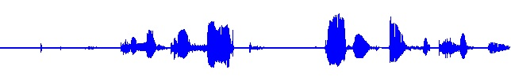
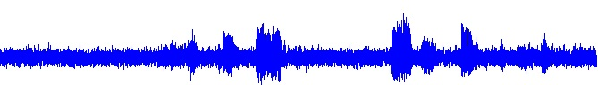
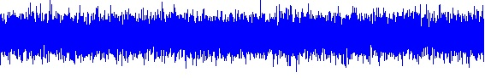
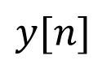
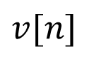
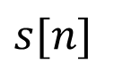
Introduction
$$s[n]$$
$$y[n]$$
+
noisy
clean
$$v[n]$$
noise

Slide 13
Introduction
What is speech enhancement!?
★
Noise Reduction.
To reduce the background noise.
Keeping the speech distortion as low as possible.
Using as a pre-processer to enhance the performance in other speech processing systems.
Speech Enhancement System
Speech Processing Systems
Speech coder
Speech recognize
Speaker recognize
Noisy Speech
Enhanced Speech

Slide 14
Introduction
Speech Enhancement System
Filtering Techniques
Spectral Restoration
Model-based Methods
Spectral Subtraction
Wiener Filter
Subspace Method
MMSE
MAP
ML
Harmonic Model
Linear Prediction
HMM

Slide 15
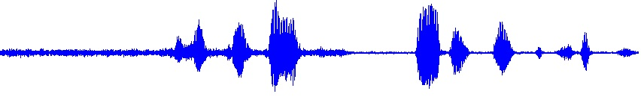
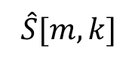
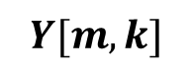

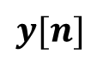
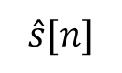
Introduction – Filtering Techniques
$$y[n]$$
$$Y[m,k]$$
$$\hat{S}[m,k]$$
$$\hat{s}[n]$$
FFT
$$×$$
IFFT
Noise tracking
Gain Estimator
VAD
MS
MCRA
Wiener Filter
clean
noisy
process
enhanced

Slide 16
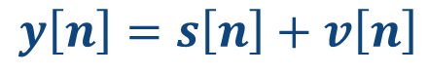
System Algorithm
★
Wiener filter 維納濾波器:
y[n]為一個含噪音的訊號可以看成是一個純淨的原始語音信號s[n]加上噪音或雜訊v[n]。
$$y\left[n\right]=s\left[n\right]+v\left[n\right]$$
期望透過濾波器濾波，使得y[n]通過濾波器後，可以濾除掉雜訊v[n]，
得到一個近似 s[n]，純淨的原始語音信號。

Slide 17
Case Study
Street + babble noise (very difficult case)
Noisy
Wiener
MMSE
GMAPA
Notes:
My singing is not bad
Or my singing will become noise and removed out

Slide 18
Wiener filter: Theory and Experiments
Step1: wav access and input process
Step2: add different noises with different SNRs
Step3: use Wiener filter and output wav
Step4: performance evaluation
Step5: Analysis and discussion

Slide 19
Suggestions
Write your report as early as possible
You do not need to know everything
Using Matlab toolbox and Google
TAs will provide some tools latter
Basic matlab codes: add noise, wiener filter
Don't belittle yourself
be an creator, not a follower
Be brave, and welcome to real-world problems
Enjoy this journey and appreciate your feedback

Slide 20
ECHO
/02

Slide 21
Outline
1
Introduction
What is echo?
Why we need to cancel echo?
2
Room Impulse Response Generator
Inventor
Concept of virtual source
定義虛擬源位置、座標
定義each impulse
3
Least Mean Square Algorithm
System Architecture
Algorithm
Mean square error

Slide 22
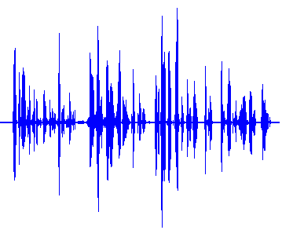
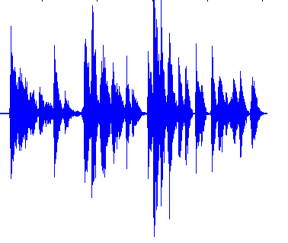
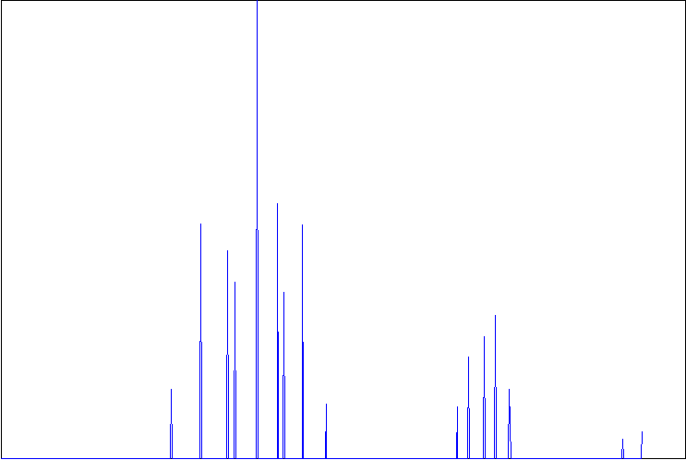
Introduction (1/2)
What is echo?
convolution
Speech
Echo
Impulse response

Slide 23
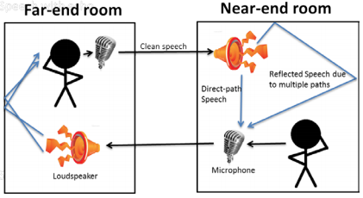
Introduction (2/2)
Why we need to cancel echo?
遠端者說話
近端揚聲器輸出
在近端的室內經過牆壁或是任何物體反射
遠端的人聽到前一個時間點自己的聲音
部分反射聲音與近端說話者聲音，一同進去近端麥克風

Slide 24
Room Impulse Response Generator
/03
Ref : A-Model-for-Room-Acoustics(附檔)

Slide 25
Room Impulse Response Generator (1/7)
★
Inventor
為S. McGovern所提供的工具，只要輸入所需參數(房間大小、喇叭位置、麥克風位置…等等)，即可模擬出一空間的 Acoustic Impulse Response以及Echo

Slide 26

Room Impulse Response Generator (2/7)
Example
Original
In church
Valley

Slide 27
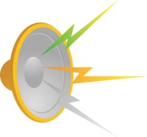
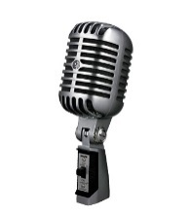
Room Impulse Response Generator (3/7)
Concept of virtual source
喇叭傳送一個信號給麥克風
★
若聲音經由牆壁反射至麥克風，聲音的路徑距離該如何計算?
假設有一個虛擬聲源傳送一直線聲音至麥克風，利用麥克風的座標、
虛擬源的座標(畢氏定理)即可獲得聲音反射路徑的距離。

Slide 28

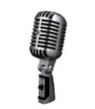
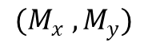
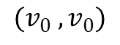
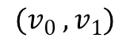
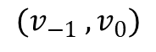
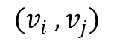
Room Impulse Response Generator (4/7)
定義虛擬源位置 (以二維圖為例子)
(B)
$$(v_{0} ,v_{1})$$
(A)
$$(v_{−1} ,v_{0})$$
$$(v_{0} ,v_{0})$$
$$(v_{i} ,v_{j})$$
$$(M_{x} ,M_{y})$$
★
首先我們定義虛擬源的位置，假設 為房間原點，給定𝑖,𝑗一個整數， (𝑖,𝑗)= (−1,0)時
虛擬源會落在(A)，依此類推， (𝑖,𝑗)= (0,1)時虛擬源落在(B)，若 (𝑖,𝑗)= (0,0)，則為實際聲
源的位置。

Slide 29
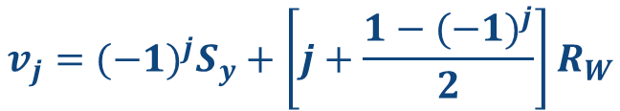
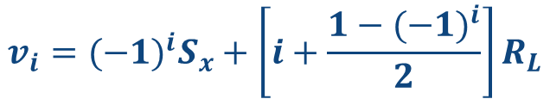
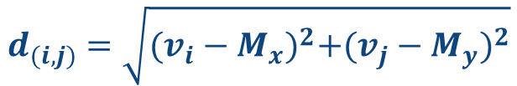
Room Impulse Response Generator (5/7)
定義虛擬源座標
1
虛擬源(𝑣_𝑖 ,𝑣_𝑗) 的座標可由下列兩個方程式來定義
$$v_{i}={(−1)}^{i}S_{x}+\left[i+\frac{1−{(−1)}^{i}}{2}\right]R_{L}$$
$$v_{j}={(−1)}^{j}S_{y}+\left[j+\frac{1−{(−1)}^{j}}{2}\right]R_{W}$$
2
到這邊我們已經成功定義了虛擬源的座標，再來我們只要利用畢氏定理即可得到虛擬源與麥克風之間的距離。
$$d_{(i,j)}=\sqrt{{(v_{i}−M_{x})}^{2}+{(v_{j}−M_{y})}^{2}}$$

Slide 30
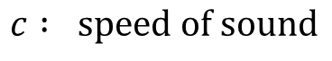
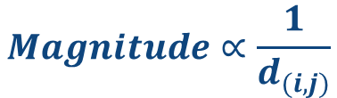
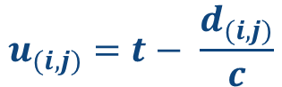
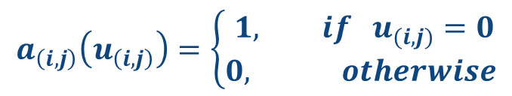
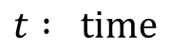
Room Impulse Response Generator (6/7)
定義each impulse
$$u_{(i,j)}=t− \frac{d_{(i,j)}}{c}$$
$$c : speed of sound$$
effective time delay of each echo
$$t : time$$
Such that $a_{(i,j)}$ is 1 when ${ u}_{(i,j)}=0$ and 0 when ${ u}_{(i,j)}≠0$
$$a_{\left(i,j\right)}\left(u_{\left(i,j\right)}\right)=\left\{\begin{aligned} 1, if { u}_{(i,j)}=0 \\ 0, otherwise\end{aligned}\right.$$
★
再來我們要修正impulse responses 的能量(虛擬源距離麥克風越遠impulse能量越小)
$$Magnitude∝\frac{1}{d_{(i,j)}}$$
其餘詳細理論推導可參考教材所附的PDF檔

Slide 31
Room Impulse Response Generator (7/7)
1
利用Room Impulse Responses Generator我們可模擬出一房間的Impulse responses (IR)，
再將聲音、IR兩者convolution即可得到該房間的Echo。
2
再來給予聲源(喇叭播出的聲音)、以及echo(麥克風收到的聲音)，LMS就可以估測此房間的IR。

Slide 32
Least Mean Square Algorithm
/04
System Architecture
Algorithm
Mean squared error
Ref : DSP期中專題二_echo (附檔)
Matlab : help LMS

Slide 33
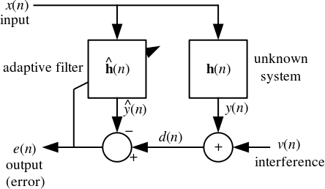
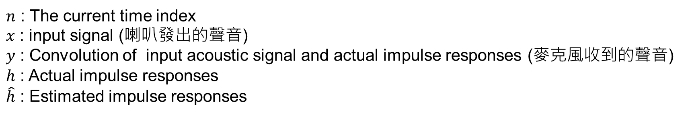
System Architecture
$n$ : The current time index
$x$ : input signal (喇叭發出的聲音)
$y$ : Convolution of input acoustic signal and actual impulse responses (麥克風收到的聲音)
$h$ : Actual impulse responses
$\hat{h}$ : Estimated impulse responses

Slide 34
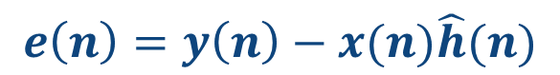


Algorithm
1
It first defines the error as
$$e\left(n\right)=y\left(n\right)−x(n)\hat{h}(n)$$
2
Afterwards, LMS iteratively updates ℎ ̂ by minimizing the least mean square error as
$$\hat{h}\left(n+1\right)=\hat{h}\left(n\right)+μe\left(n\right)x(n)$$
$μ$ : Step size (決定error收斂速度的快慢)

Slide 35

Mean squared error (均方差，MSE)
1
均方差為一般評估誤差常用的方式之一，求出來的MSE值越小，表示$h$與$\hat{h}$̂之間的差異少，也就代表回音消除效果越好。
2
此實驗中MSE計算方法為：
$$10\log_{10}{{e(n)}^{2}}$$
3
此計算方法在本實驗中有兩個用途 :
將單位轉換成 dB
可觀察 error 收斂趨近於0時的詳細數值

Slide 36

Mean squared error (均方差，MSE)
Example
此圖代表 :
error在約第𝟓萬次疊代時開始收斂，
，且error在${10}^{−16}$後開始有值。

